Slide 1
ECDC COVID 19 WW
File created on: 02-04-2020 16:54:32

Slide 2
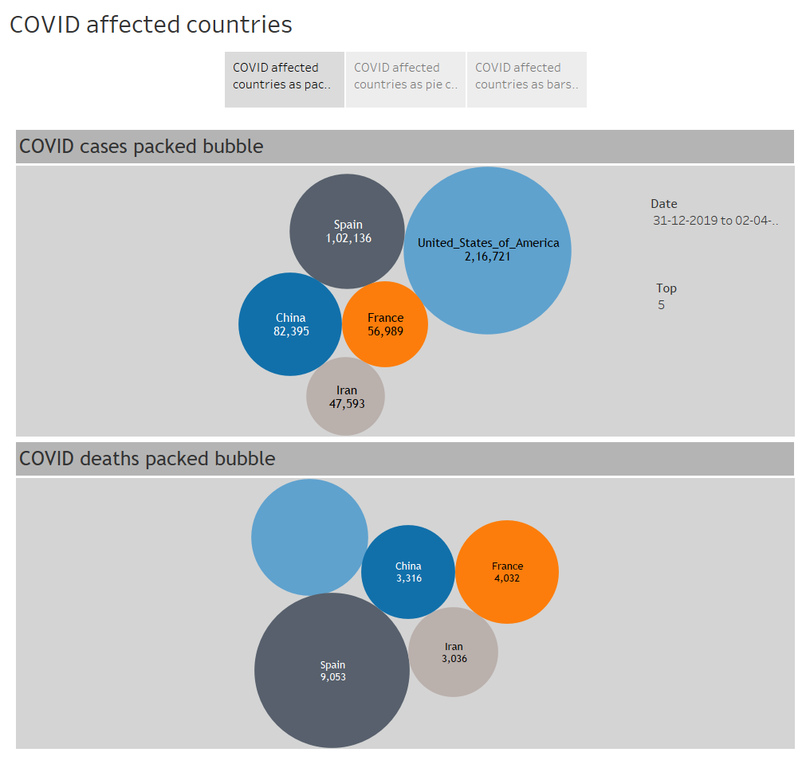

Slide 3
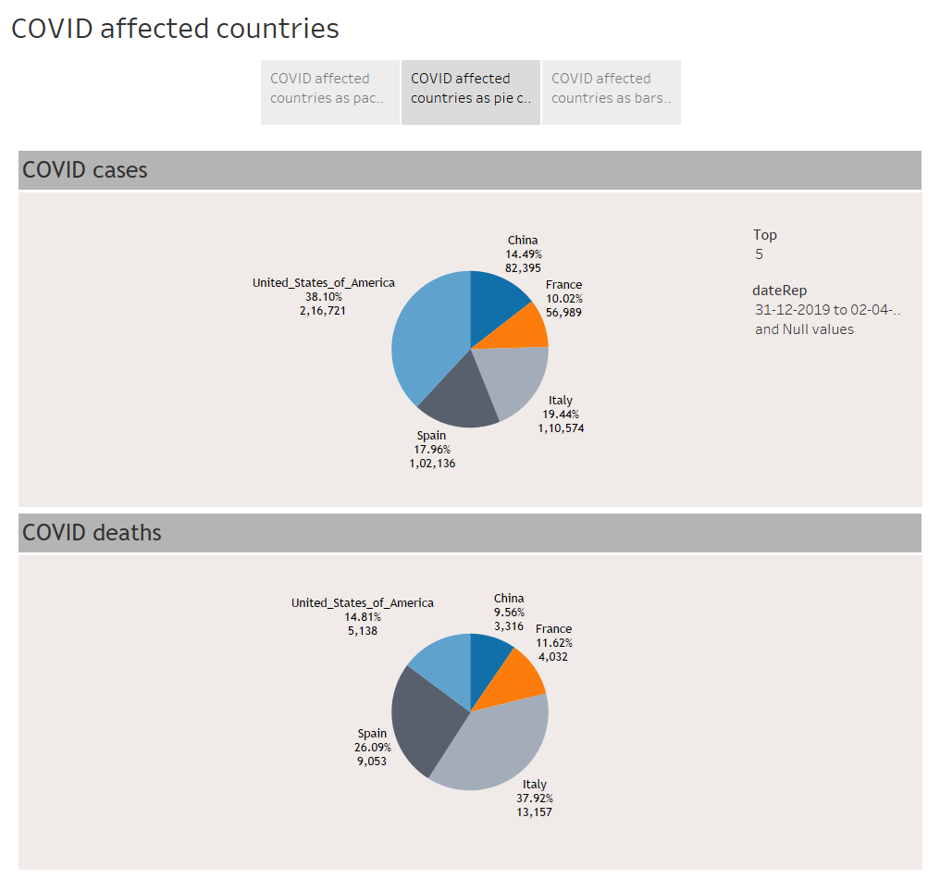

Slide 4
